Slide 1
Employee attrition Analysis
Using excel
By:-
Amandeep Kaur

Slide 2
Problem Statement
Employee attrition is a major challenge for organizations as it increases hiring costs, reduces productivity, and impacts team stability.
This project aims to analyze key factors influencing employee attrition.

Slide 3
Objectives
• To measure attrition patterns
• To identify factors affecting attrition
• To derive actionable business insights
DATASET
HR Analytics

Slide 4
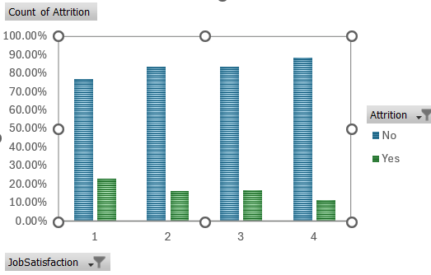
KEY ANALYTICS
1.Job Satisfaction
INSIGHTS:-
Low job satisfaction shows Higher Attrition Rate(22.84%)
High job satisfaction shows Lower Attrition Rate(11.33%)
Recommendations:
Manager training programs
Workload balancing initiatives

Slide 5
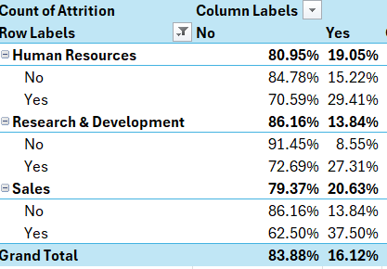
2.Department-Wise Attrition
INSIGHTS:-
Sales department has the highest attrition rate(20.63%)with highest overtime frequency
Recommendations:-
Redesign Sales Incentives
Reduce Burnout through shift balancing

Slide 6
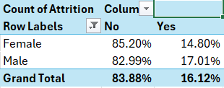
3.Attrition Rate by Gender
Insights:-
Male employees exhibit slightly higher attrition compared to female employee suggesting potential differences in job satisfaction, workload, or role distribution.
Recommendations:-
Retention policies should avoid assumptions based on gender and instead rely on behavioural and performance metrics.

Slide 7
4.OVERTIME ANALYSIS
Insights:-
Employees working overtime exhibit significantly higher attrition rates, suggesting workload pressure as a major retention risk.
Recommendations:-
Implement policies promoting work-life balance, including flexible scheduling and overtime control. Reducing sustained workload pressure may help mitigate voluntary turnover.”

Slide 8
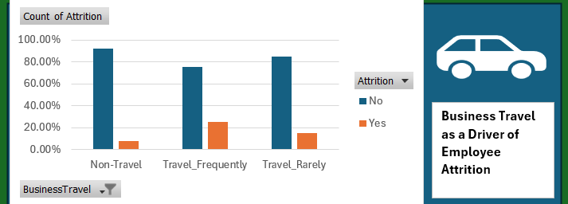
Business Travel as a Driver of Employee Attrition
INSIGHTS:-
Attrition rates increase consistently with business travel frequency. Employees who travel frequently show the highest attrition risk (24.91%), nearly three times that of non-travel employees (8.00%).
RECOMMENDATIONS:-
Employees with frequent travel assignments should be treated as a high attrition-risk segment. Travel load balancing and rotation strategies can help reduce turnover.

Slide 9
Summary & Conclusion
• Employee attrition is primarily influenced by workload-related factors rather than demographics
• Overtime and frequent travel emerged as the most significant attrition drivers
• Clear patterns indicate higher turnover risk under sustained work pressure
• Data-backed insights highlight opportunities for targeted retention strategies
Overall Conclusion
Attrition is largely driven by employee work conditions and stress-related variables.

Slide 10


